Slide 1
Front End Engineering-I Project
Team Details:
Raghav Kaushal : 2210990699
Raghav Nagi : 2210990700
Raghav Thakur: 2210990701
Rahul Sharma: 2210990702
Faculty Coordinator:
Dr. Mandeep Kaur
:
Chitkara University Institute of Engineering and Technology,
Chitkara University, Punjab

Slide 2
Table of Contents
Introduction
Problem Statement
Technical Details
Key Features
Project Highlights
Conclusion
References/Links used

Slide 3
Introduction
Google Search Engine Lookalike
Team members:
Raghav Kaushal: 2210990699
Raghav Nagi: 2210990700
Raghav Thakur: 2210990701
Rahul Sharma: 2210990702
Purpose and Goal:
To get knowledge about the Google search engine and achieve the goal of making a lookalike.

Slide 4
Problem Statement
The project aims to create a duplicate of Google search engine which makes things easily searched. Firstly the layout of the Google engine was understood and going further the working of the engine was observed. Although the project is not as advanced as Google, it allows much of the task to be performed.

Slide 5
Technical Details
The project helps the user to search for various things on the internet. Their use of HTML, CSS, and Javascript in the project. Where HTML provides the structure of the project, CSS contribute to making the project look hermoso and Javascript is the most important part of the project which helps to do various search just like the Google search engine.

Slide 6
Key Features
This slide should include Key features needed to solve the problem.

Slide 7
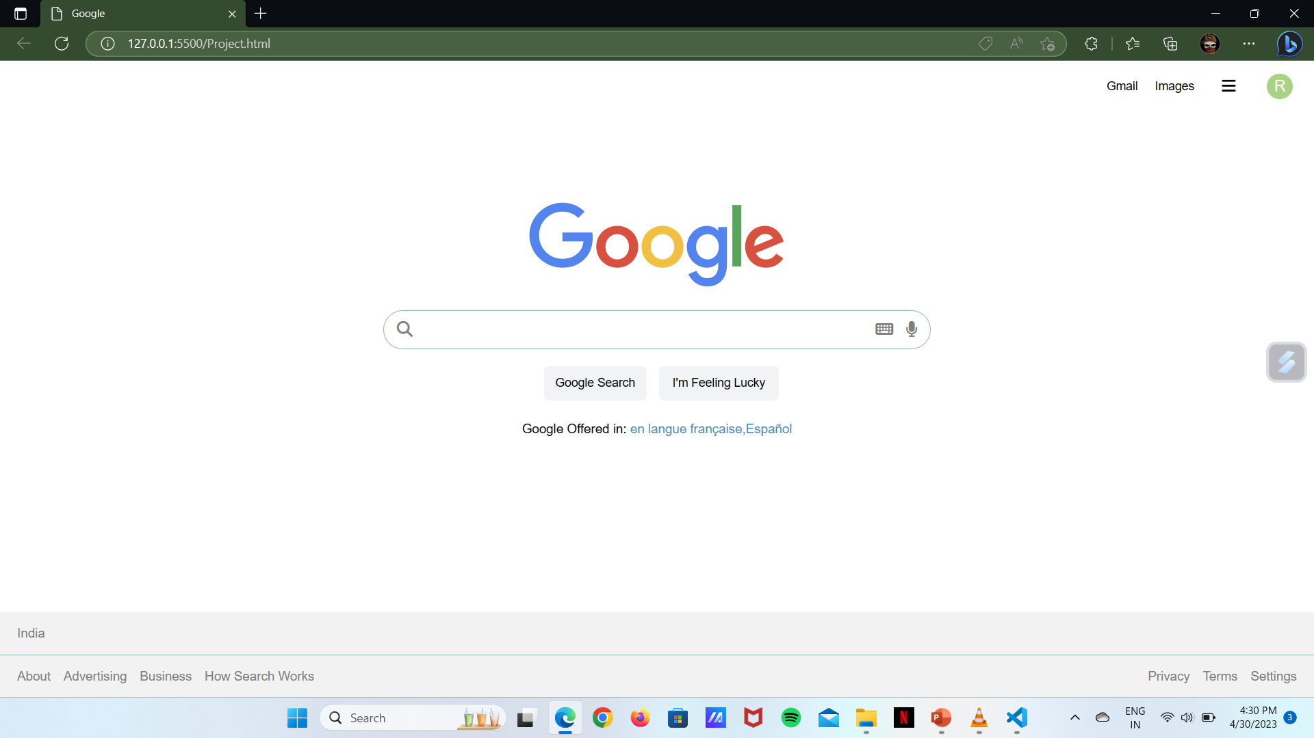
Project Highlights

Slide 8
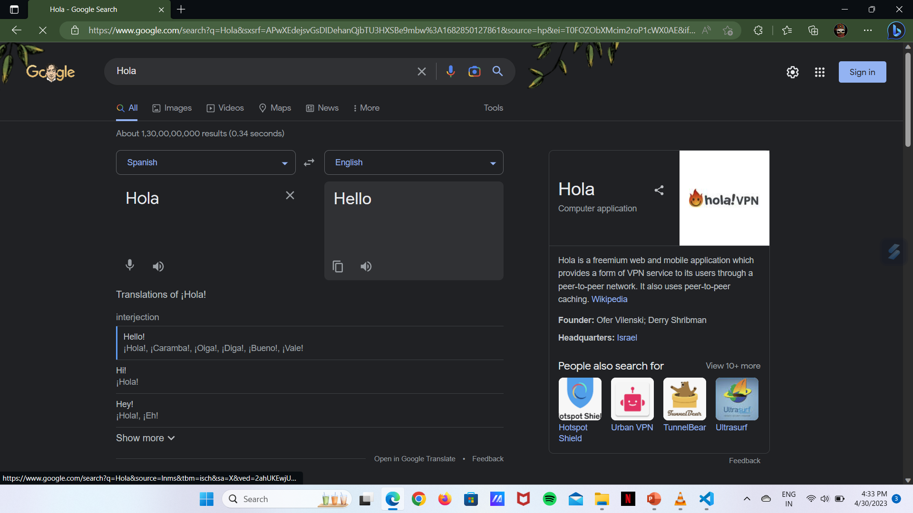
Project Highlights

Slide 9
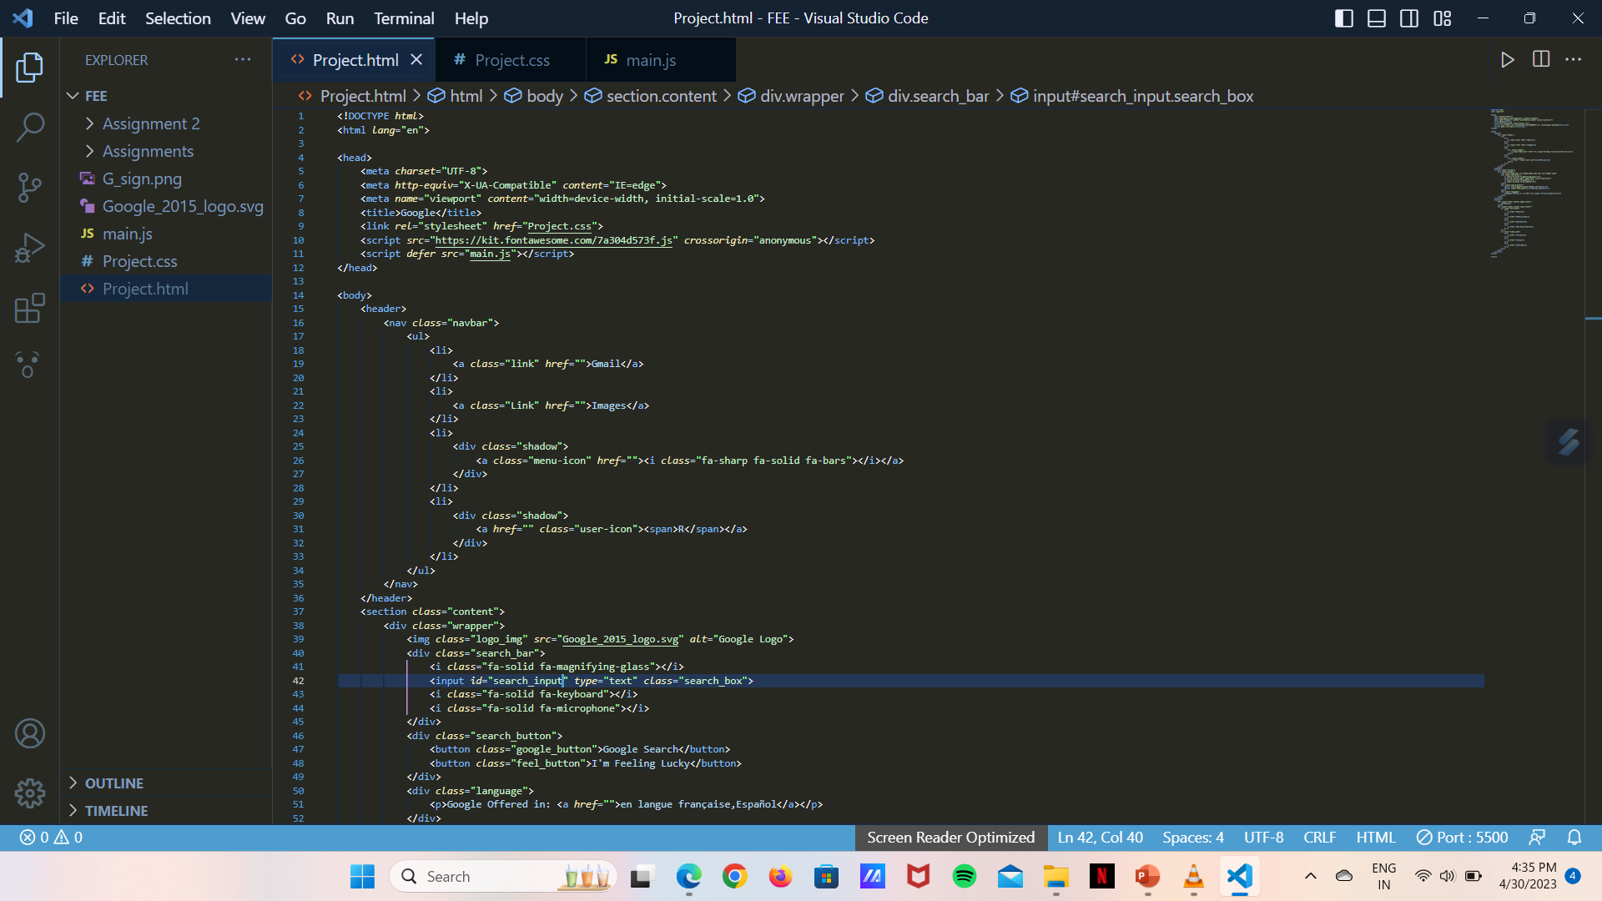
HTML Code

Slide 10
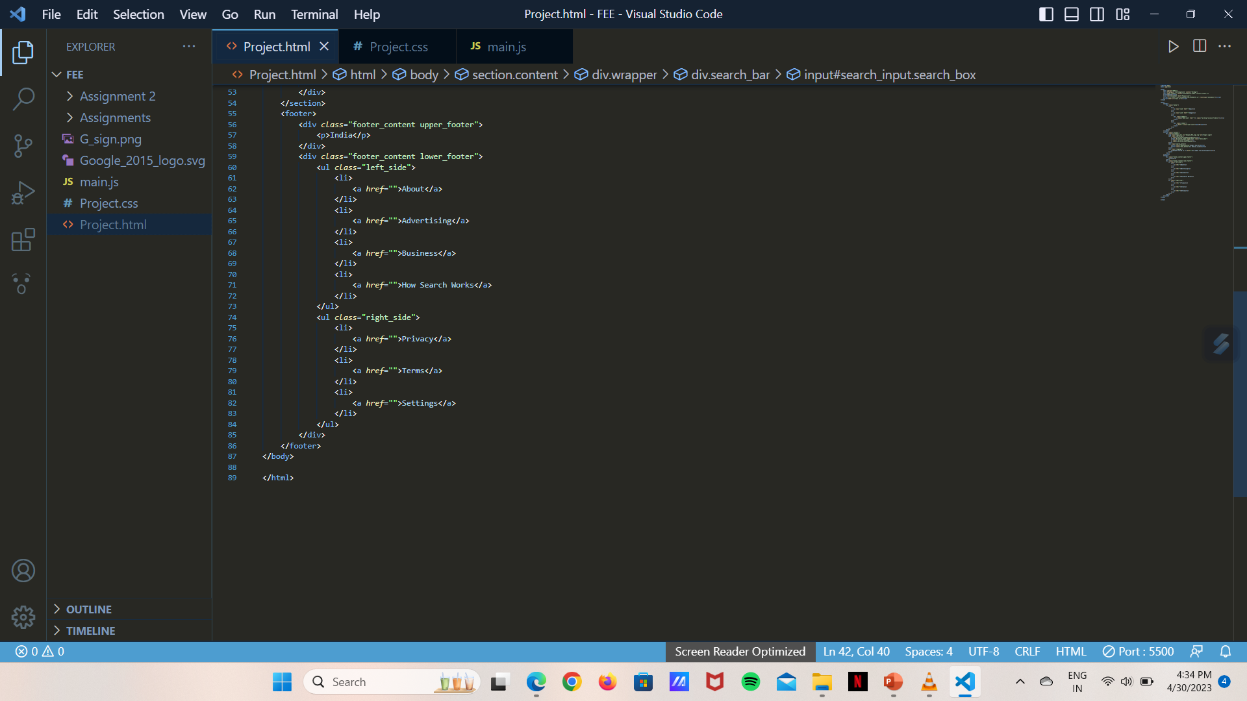
HTML Code

Slide 11
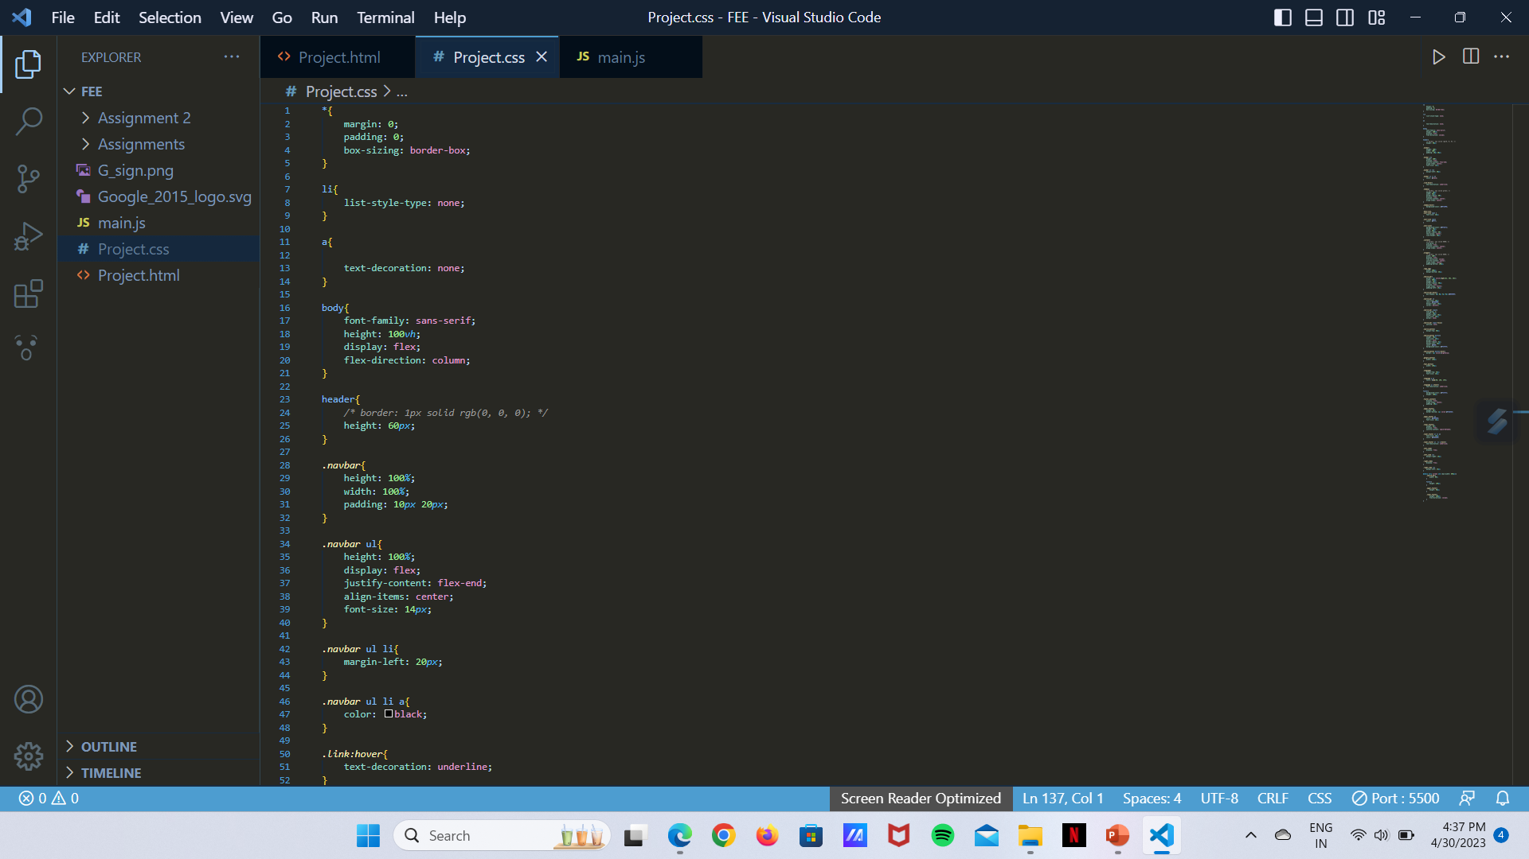
CSS Code

Slide 12
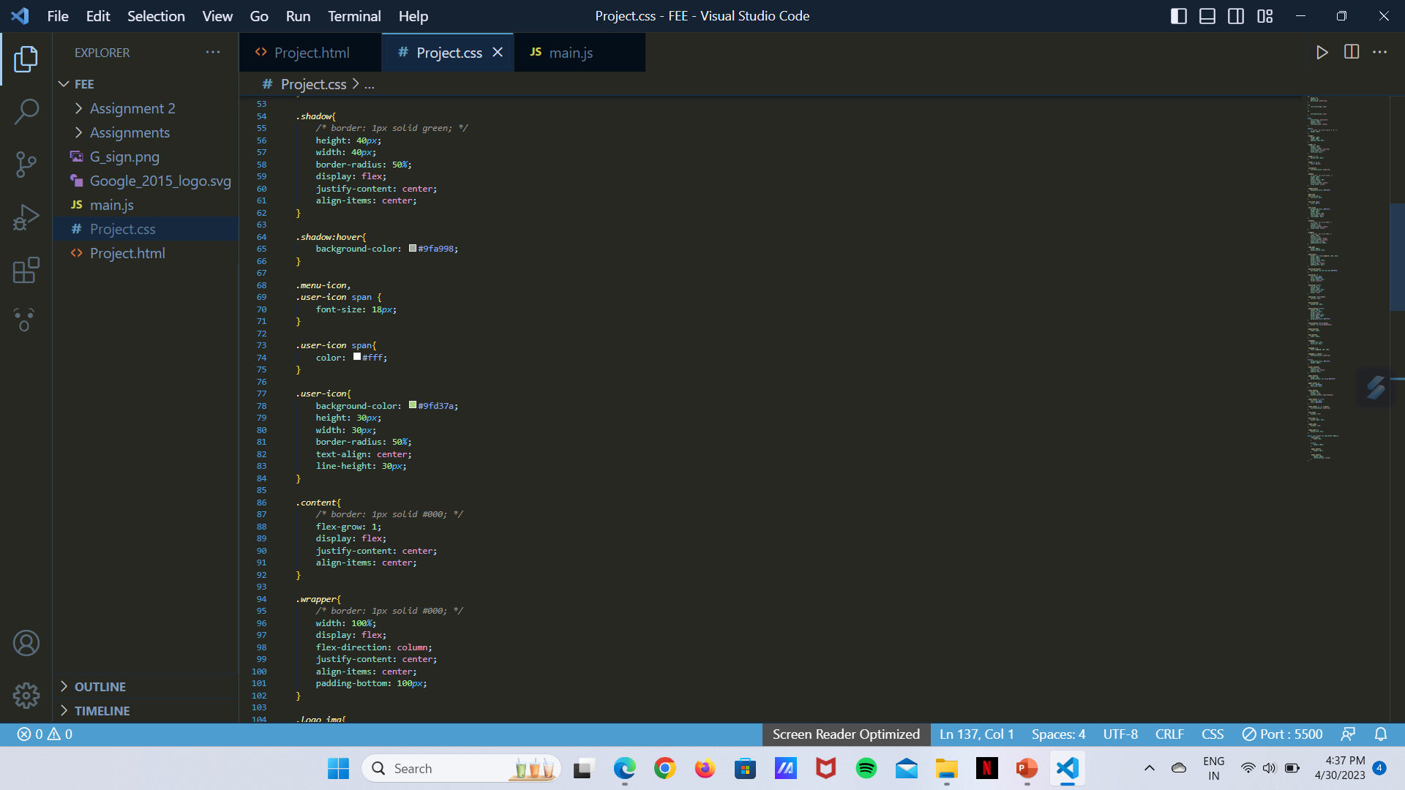
CSS Code

Slide 13
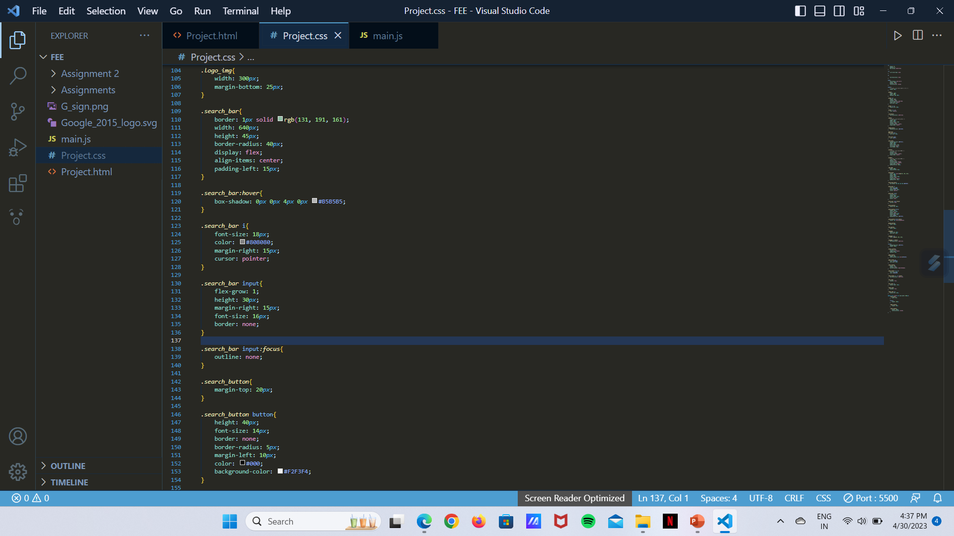
CSS Code

Slide 14
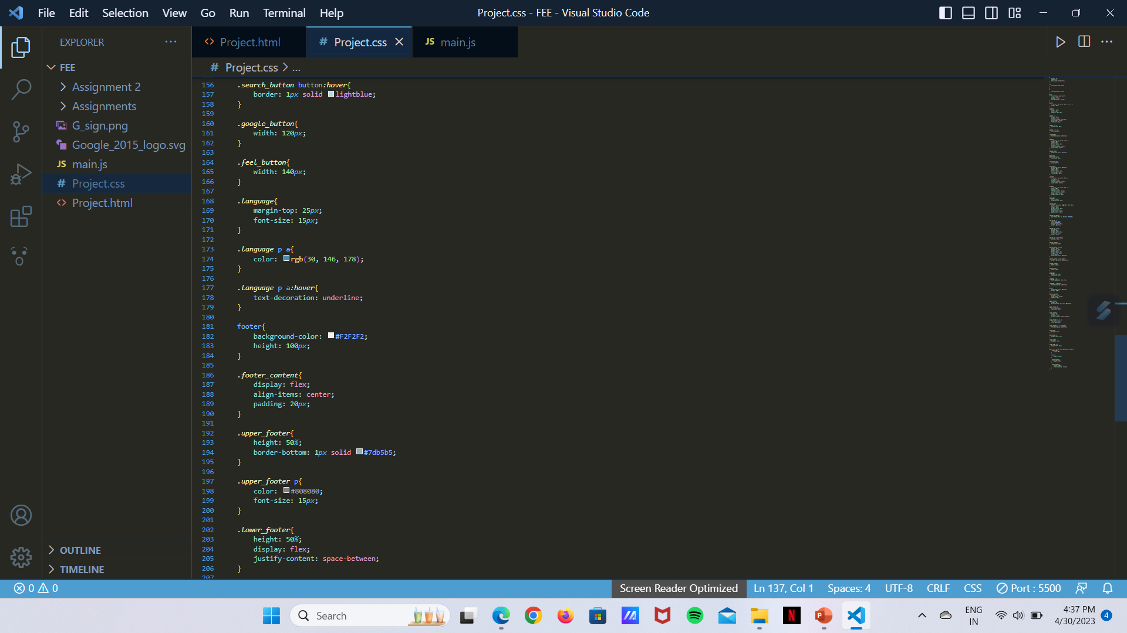
CSS Code

Slide 15
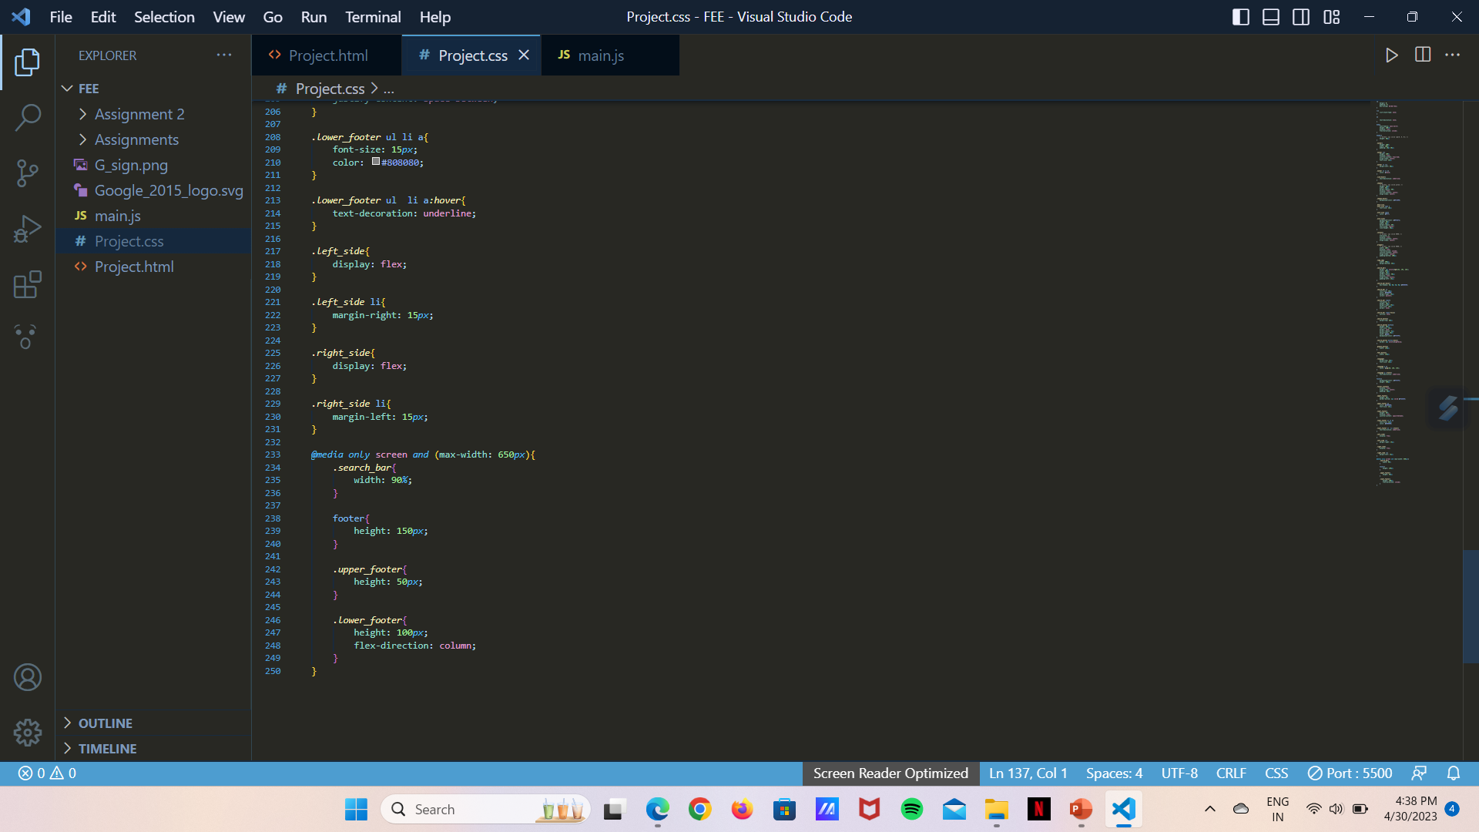
CSS Code

Slide 16
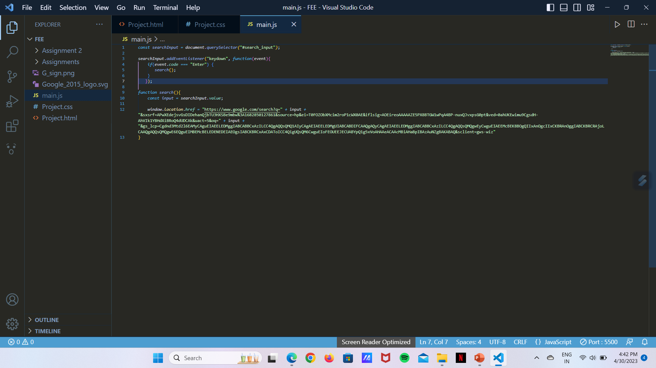
Javascript Code

Slide 17
Conclusion
The main key feature of the project is that the user will experience just similar to the experience they receive from the environment provided by Google. The team experienced the way In which the projects are created, how to perform tasks when we are in the team, understand the responsibilities a team member has to perform, and most importantly the time management which each should have to take care of so the outer members of the team doesn’t suffer.

Slide 18
References/Links used
Google.com
Youtube
Wikipedia
Greek4Greeks

Slide 19


